Slide 1
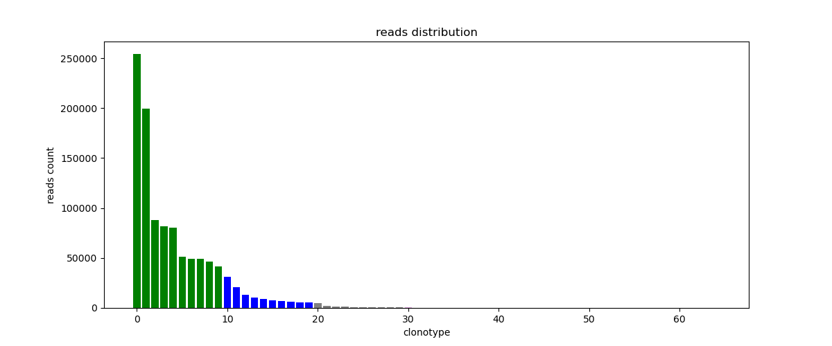

Slide 2
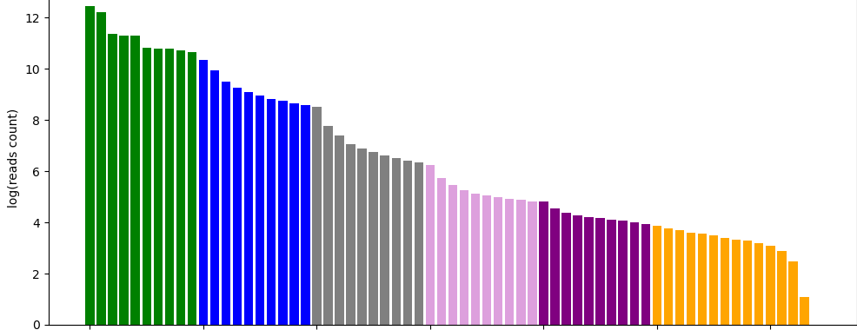
Top10 clonotypes
Top 10-100
clonotypes
Top 100-1000 clonotypes
Top1000-10000 clonotypes
Top 10000-100000 clonotypes
Top 100000+ clonotypes

Slide 3
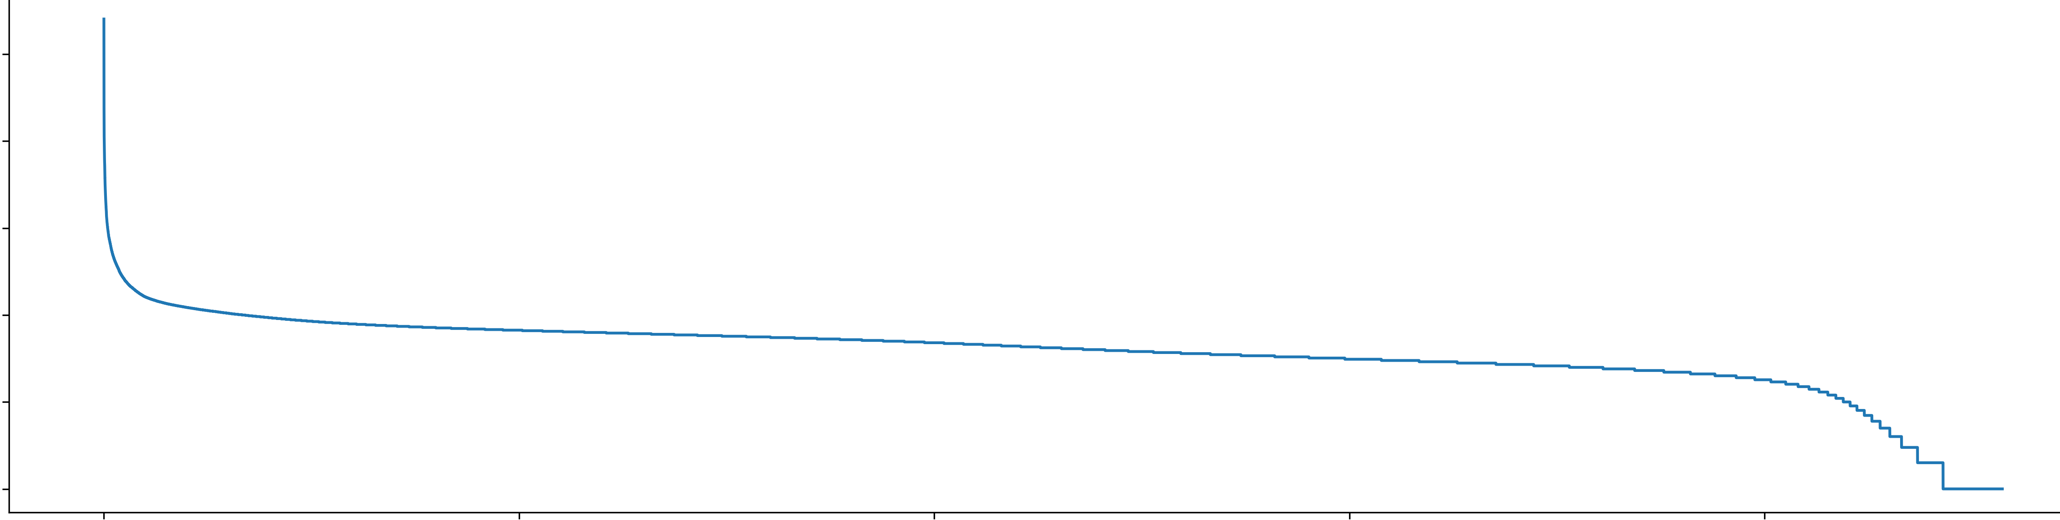
10k
1000
100
10

Slide 4
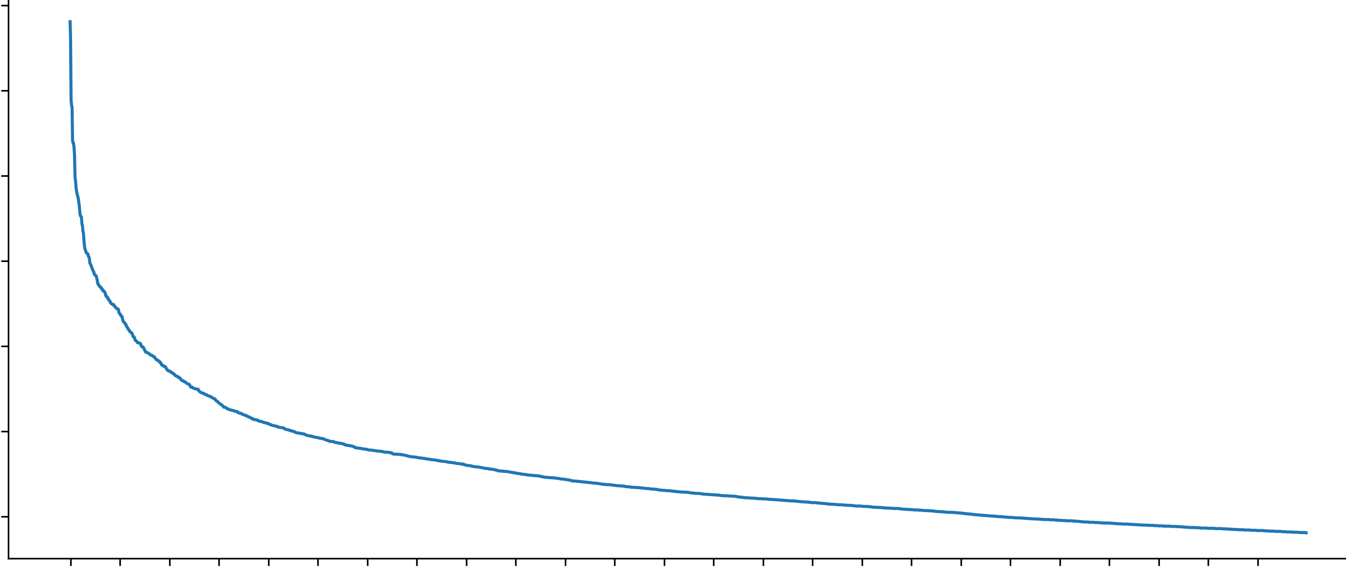
100k
10k
1k
100

